Slide 1
Reinforcement learning for dynamic obstacle
Team members of alpha group: Tianyi gu
mostafa Hussein
Yishan luo
Yuncong zhou
Sangeeta Patnaik
Collin crowell

Slide 2
Brief of the presentation
Introduction
Communication
Elements in process
Process
Mathematical equation
Future work

Slide 3
introduction
motivation
Avoiding dynamic obstacle are crucial
autonomous vehicle navigation
Indoor robot navigation
Project:
Learn behavior of the dynamic obstacle
Through proper training using the algorithm
Come up with a good policy

Slide 4
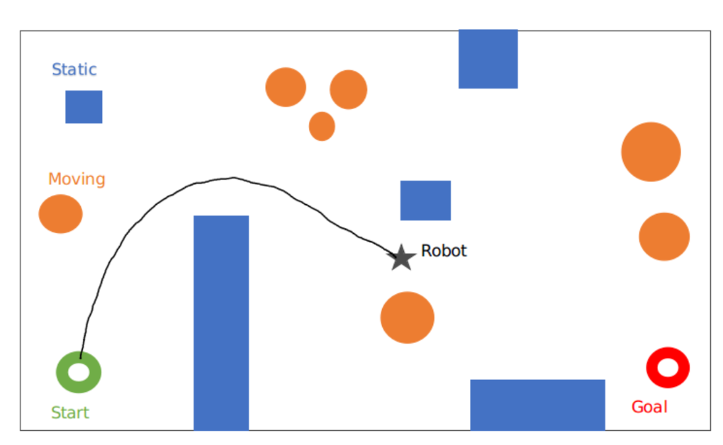
environment

Slide 5
DETERMINSTIVC VS STOCHASTIC
DETERMINSTIC APPROACH:
Environment is known to the agent
There could be some time varying parameters in real time
Easy to calculate path
Stochastic approach:
In cooperates uncertainty
Unpredictable parameter behavior
Complexity is much bigger in magnitude
Calculation of path is obtained through training

Slide 6
assumption
we assume that both the algorithms theoretically holds the same concept and we want to come up with a proof to show it experimentally, by comparing the reward value in stochastic approach vs the cost function in deterministic approach.

Slide 7
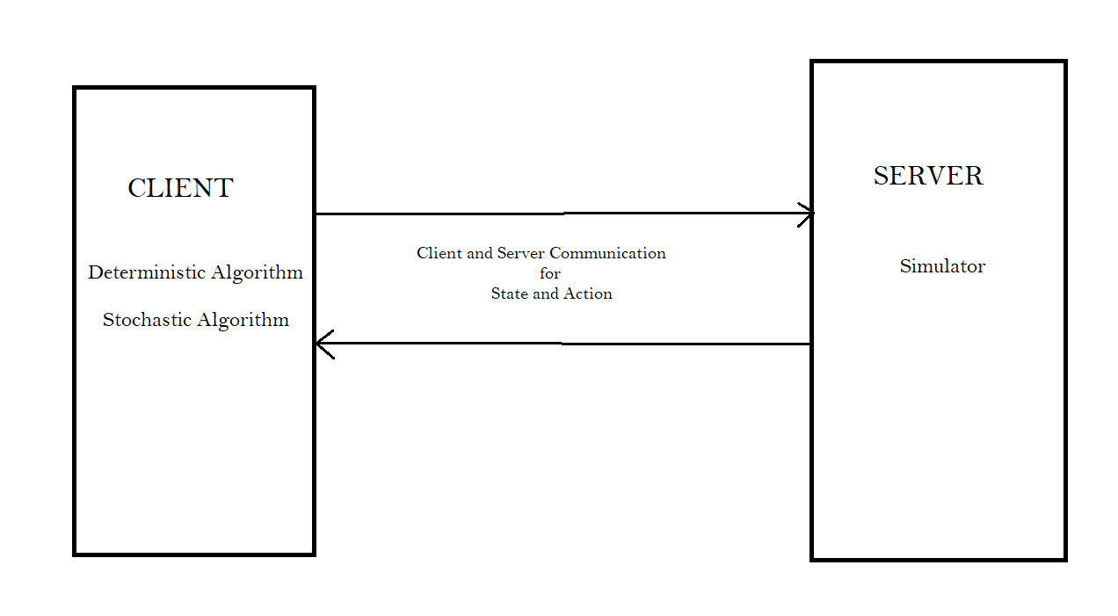
Socket programming for communication

Slide 8
Simulator
1.1 CURRENT PROGRESS:
Socket based communication with the algorithm module.
Text based Visualization
Real time mode
Simulation mode
1.2 Future work
Graphical interface : web based or python graphics
Configurable movement speed of both agent and dynamic obstacle

Slide 9
DETERMINSTIC ALGORITHM
2.1 current progress
Socket based communication with simulator
Implemented a* algorithm that treat dynamic obstacle as static obstacle.
2.2 future work
Dynamic obstacle movement prediction
Real time search algorithm: lss-lrta*

Slide 10
Stochastic algorithm
3.1 current progress
Socket based communication with simulator
Implemented offline training with q-learning and sarsa
3.2 future work
Bring offline training into online training
Improve q-value look up table to value approximation function
Implementing lspi

Slide 11
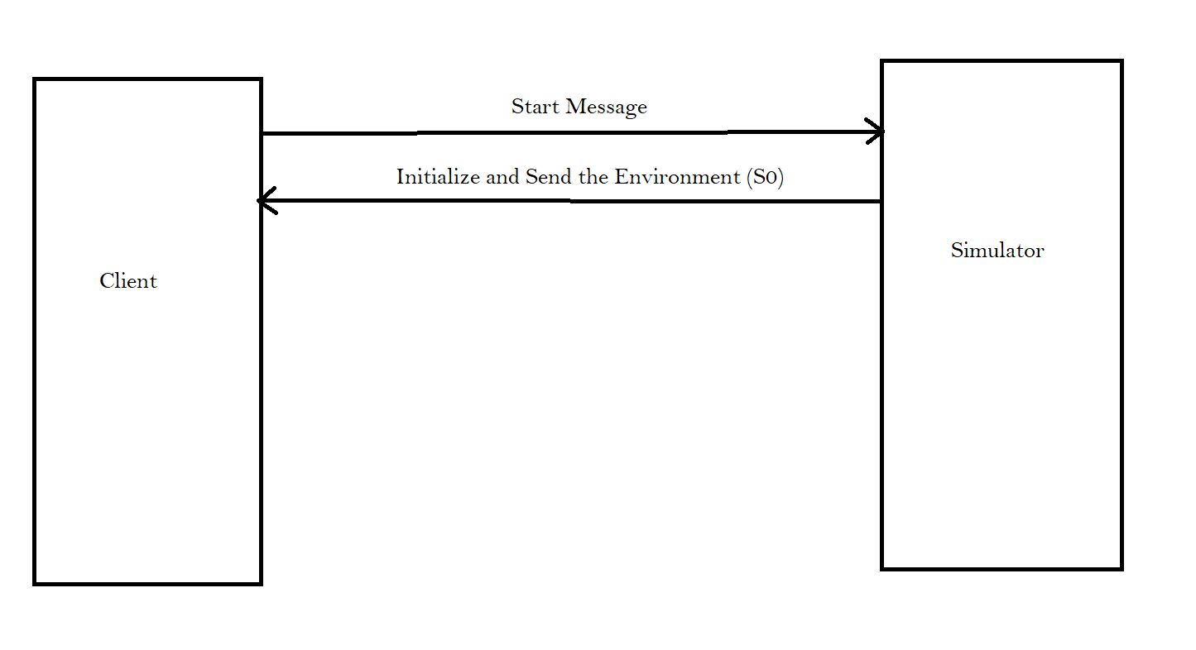
step 1 : sending environment

Slide 12
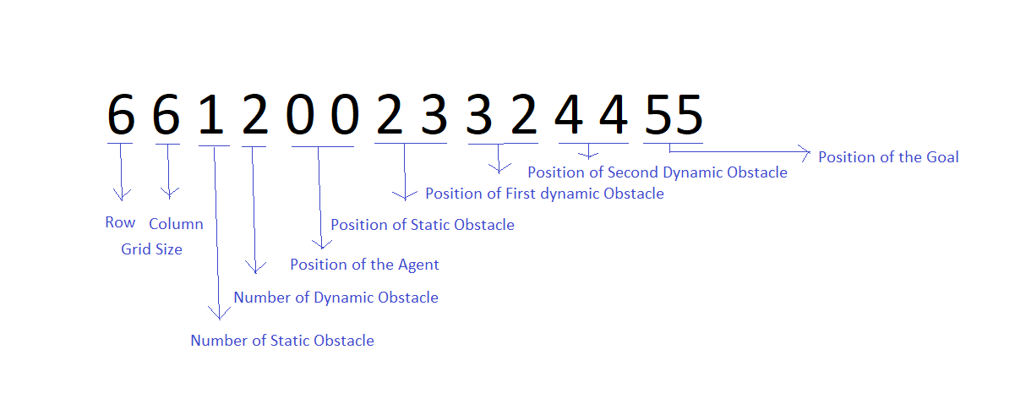
Step 2 : environment in the form of string

Slide 13
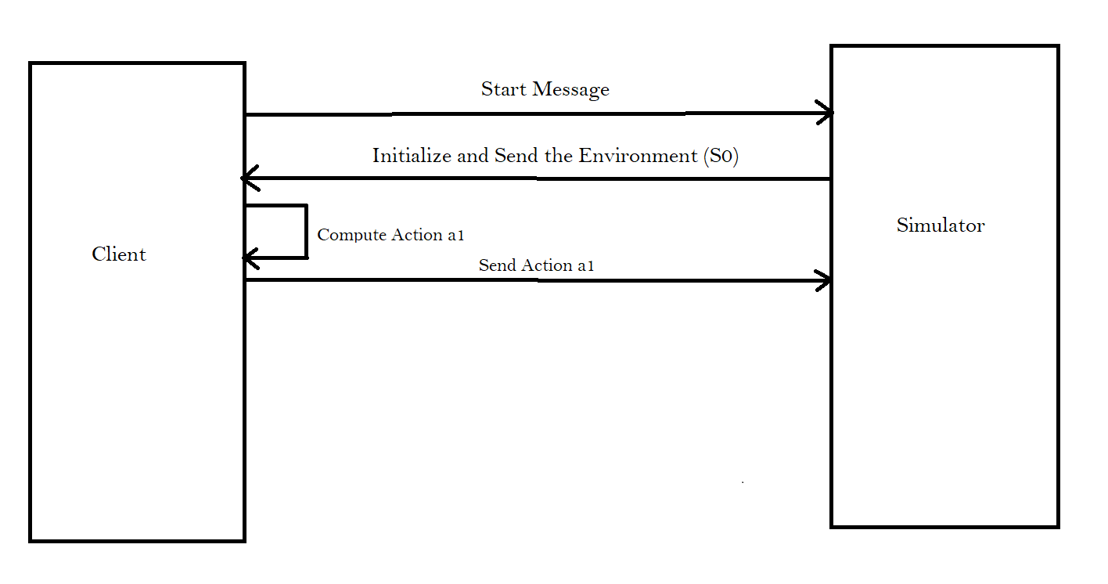
Step 2 : algorithm Compute action and send

Slide 14
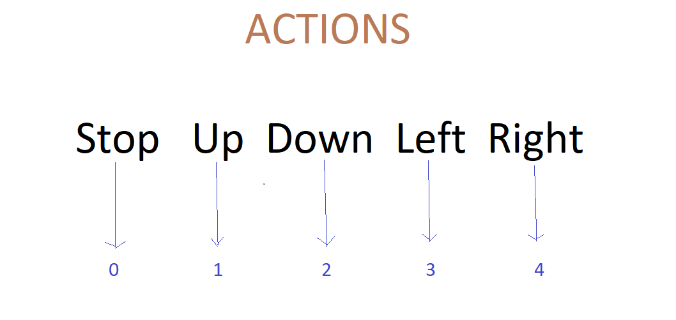
actions

Slide 15
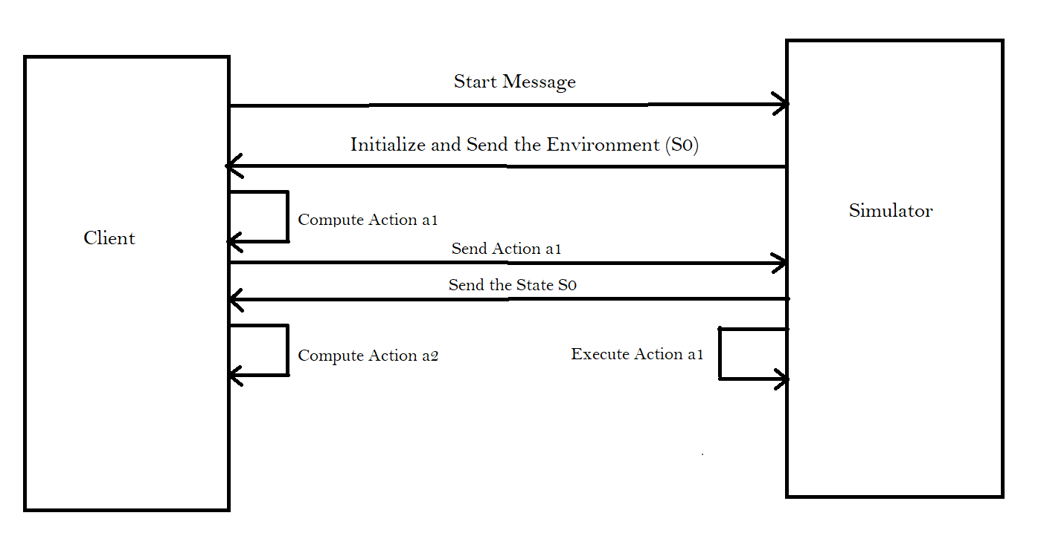
Step 3 : compute and execution

Slide 16
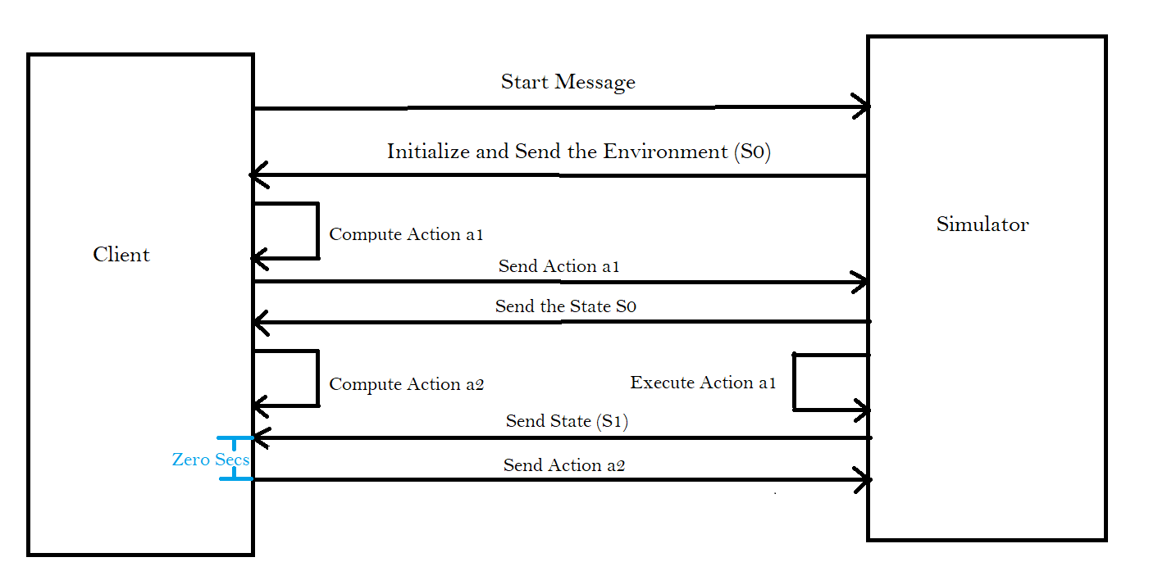
Step 4 : loop explanation

Slide 17
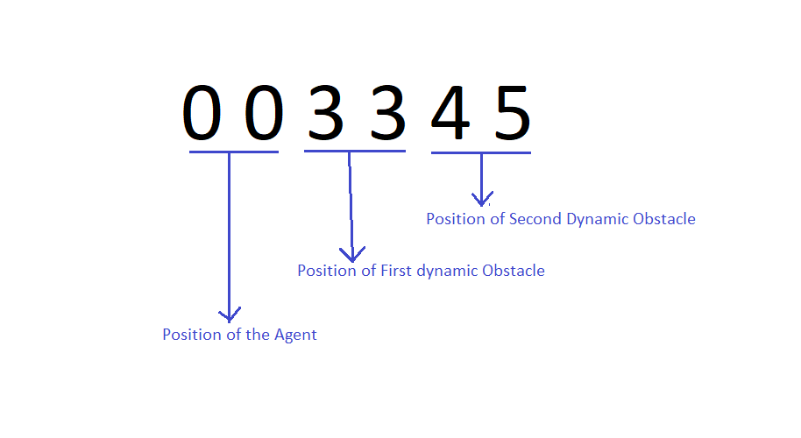
sending the state s1

Slide 18
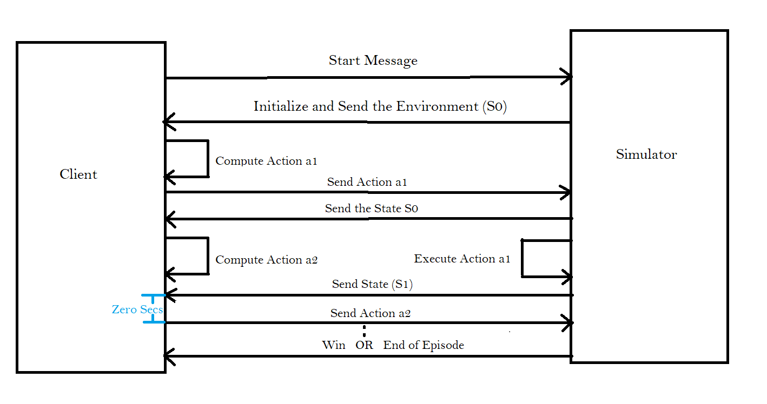
Final step of training

Slide 19
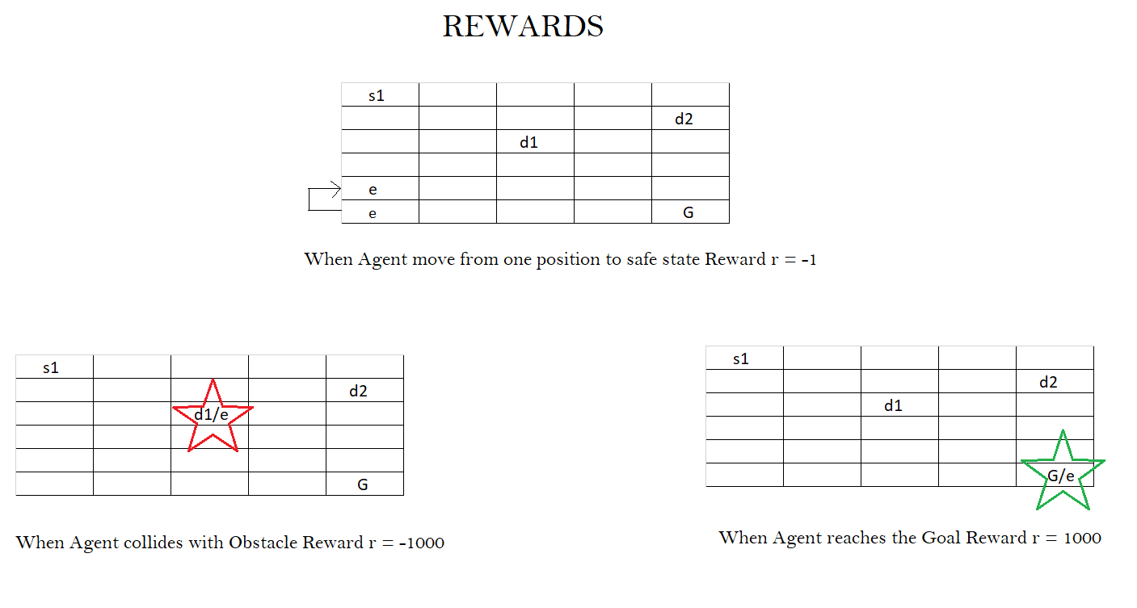
state and reward

Slide 20
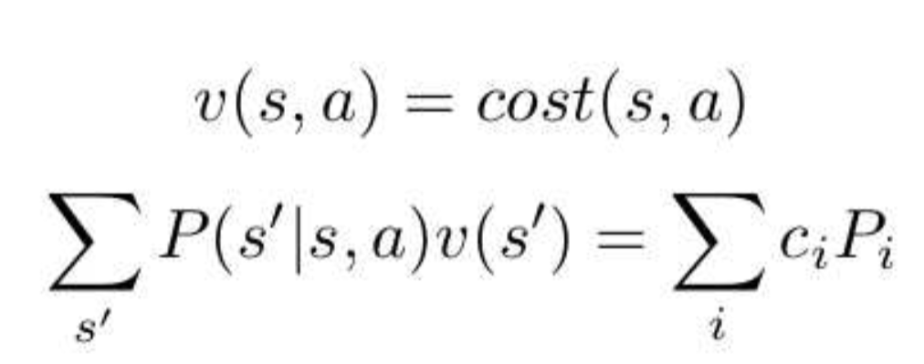
mathematical equation
Current progress
Hypothesis: assume the system terminates immediately when the agent hits an obstacle or achieve a goal position (no future reward), then the following equation hold:
Future work:
Theoretically prove the claim
Show a lot of experiment results that support the proof

Slide 21
Future work
Comparison between different algorithms

Slide 22
.
Thank you

